Slide 1

OOP LAB 6 (25 Oct 22)
C# Object Oriented Programming
By: Miss Tia

Slide 2
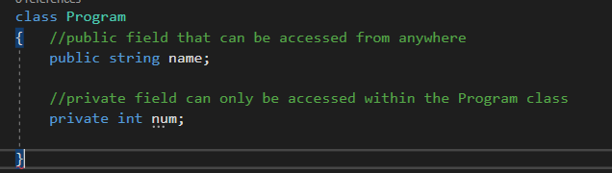
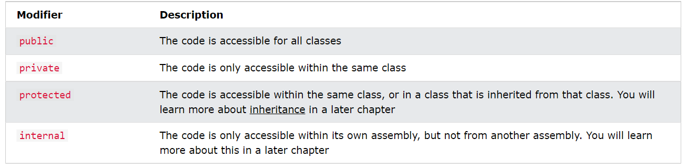
Access Modifier
Why Access Modifiers? To control the visibility of class members (the security level of each individual class and class member). To achieve "Encapsulation" - which is the process of making sure that "sensitive" data is hidden from users.
In C#, there are 4 basic types of access modifiers.
public
private
protected
internal

Slide 3
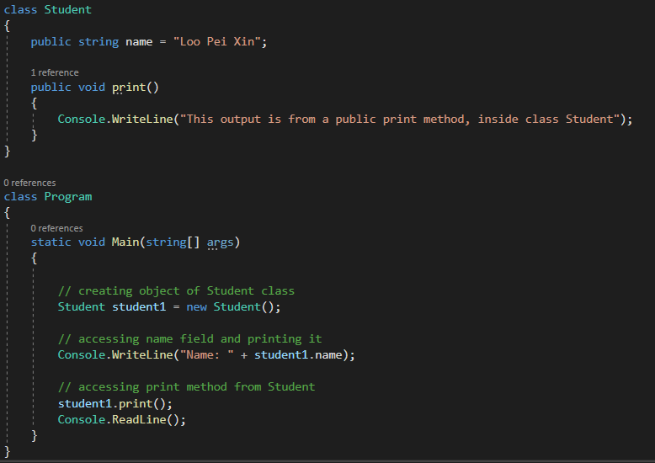

Public Access Modifier
When we declare a type or type member public, it can be accessed from anywhere. For example:
created a class name ‘Student’
created method ‘print()’
Output:
Since the field and method are public, we are able to access them from the Program class.

Slide 4
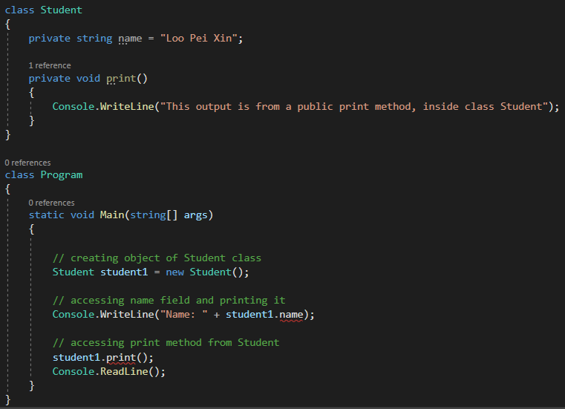

Private Access Modifier
When we declare a type member with the private access modifier, it can only be accessed within the same class or struct. For example:
created a class name ‘Student’
created method ‘print()’
Output:
Since the field and method are private, we cannot access them from the Program class.
Note: By default, all members of a class are private if you don't specify an access modifier:

Slide 5
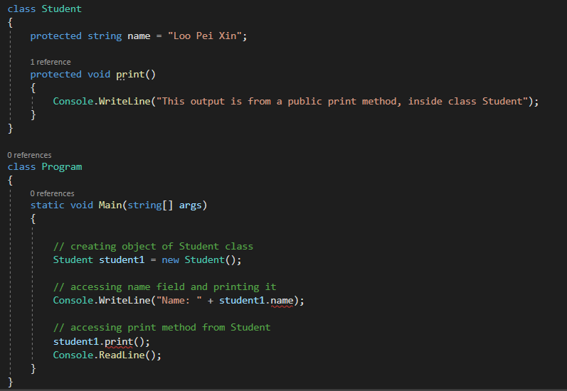
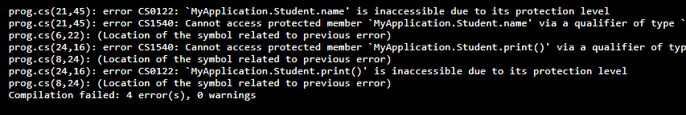
Protected Access Modifier
When we declare a type member as protected, it can only be accessed from the same class and its derived classes. For example,:
created a class name ‘Student’
created method ‘print()’
Output:

Slide 6

Protected Access Modifier
How to access it? inheriting the Program class from the Student class.
Output:

Slide 7

Let the debugging begins
​Exercise: create class animal and cat (or any other animal you choose). Utilize the protected access modifier and inheritance.
Output:

Slide 8
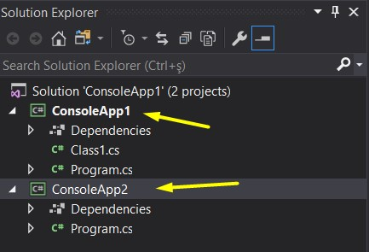
Internal Access Modifier
When we declare a type or type member as internal, it can be accessed only within the same assembly.
An assembly is a collection of types (classes, interfaces, etc) and resources (data). They are built to work together and form a logical unit of functionality.
In .NET and .NET Framework, you can build an assembly from one or more source code files. In .NET Framework, assemblies can contain one or more modules. This way, larger projects can be planned so that several developers can work on separate source code files or modules, which are combined to create a single assembly.

Slide 9
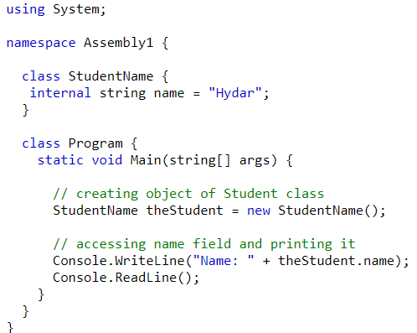
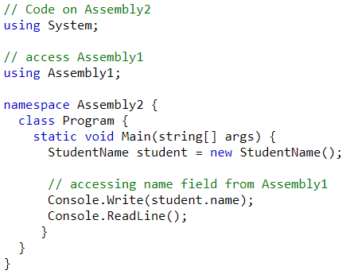
Internal Access Modifier
When we declare a type or type member as internal, it can be accessed only within the same assembly.
In the above example, we have created a class named StudentName with a field name. Since the field is internal, we are able to access it from the Program class as they are in the same assembly. If we use internal within a single assembly, it works just like the public access modifier.
this code is in Assembly2. We are trying to access the name field of the StudentName class(Assembly1). To access fields from Assembly1, we first need to set the reference of Assembly1 in Assembly2. However it still return an error

Slide 10
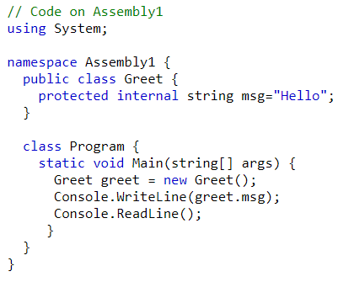
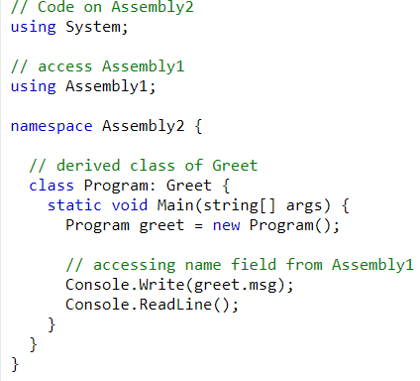
Protected Internal Access Modifier
The protected internal is a combination of protected and internal access modifiers. When we declare a member protected internal, it can be accessed from the same assembly and the derived class of the containing class from any other assembly.
In the above example, we have inherited the Program class from the Greet class (from Assembly1). We are able to access the msg from the Greet class of Assembly1 from Assembly2. This is because the msg is a protected internal field and we are trying to access it from the child class of Greet.

Slide 11
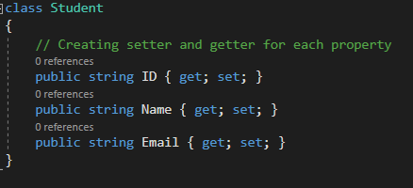
C# Encapsulation Properties (Get and Set)
The meaning of Encapsulation, is to make sure that "sensitive" data is hidden from users.
declare fields/variables as private
provide public get and set methods, through properties, to access and update the value of a private field
The purpose of encapsulation is to prevent alteration of data from outside. This data can only be accessed by getter functions of the class. A fully encapsulated class has getter and setter functions that are used to read and write data. This class does not allow data access directly.
Better control of class members (reduce the possibility of yourself (or others) to mess up the code)
Fields can be made read-only (if you only use the get method), or write-only (if you only use the set method)
Flexible: the programmer can change one part of the code without affecting other parts
Increased security of data

Slide 12
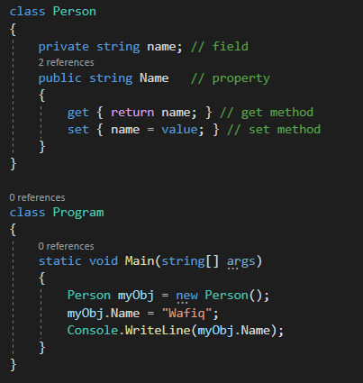

C# Properties (Get and Set)
You learned from the previous chapter that private variables can only be accessed within the same class. However, sometimes we need to access them - and it can be done with properties.
A property is like a combination of a variable and a method, and it has two methods: a get and a set method:
Output:
The Name property is associated with the name field. It is a good practice to use the same name for both the property and the private field, but with an uppercase first letter.
The get method returns the value of the variable name.
The set method assigns a value to the name variable. The value keyword represents the value we assign to the property.
Now we can use the Name property to access and update the private field of the Person class:

Slide 13
Let the debugging begins
​Exercise: create class animal and cat (or any other animal you choose). Utilize the protected access modifier and encapsulation properties

Slide 14

C# Inheritance
In C#, it is possible to inherit fields and methods from one class to another. We group the "inheritance concept" into two categories:
Derived Class (child) - the class that inherits from another class
Base Class (parent) - the class being inherited from
It is useful for code reusability: reuse fields and methods of an existing class when you create a new class.
Polymorphism, which uses inherited methods to perform different tasks.
The sealed
If you don't want other classes to inherit from a class, use the sealed keyword: If you try to access a sealed class, C# will generate an error:

Slide 15
C# Inheritance
In C#, it is possible to inherit fields and methods from one class to another. We group the "inheritance concept" into two categories:
Derived Class (child) - the class that inherits from another class
Base Class (parent) - the class being inherited from
It is useful for code reusability: reuse fields and methods of an existing class when you create a new class.
Polymorphism, which uses inherited methods to perform different tasks.
The sealed
If you don't want other classes to inherit from a class, use the sealed keyword: If you try to access a sealed class, C# will generate an error:

Slide 16
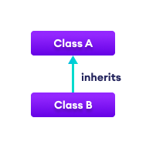
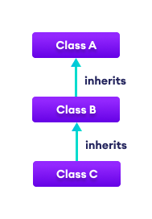
Single & Multilevel Inheritance
In single inheritance, a single derived class inherits from a single base class.
In multilevel inheritance, a derived class inherits from a base and then the same derived class acts as a base class for another class.

Slide 17
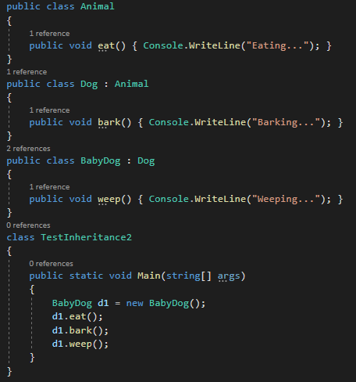

Multilevel Inheritance
Output:

Slide 18
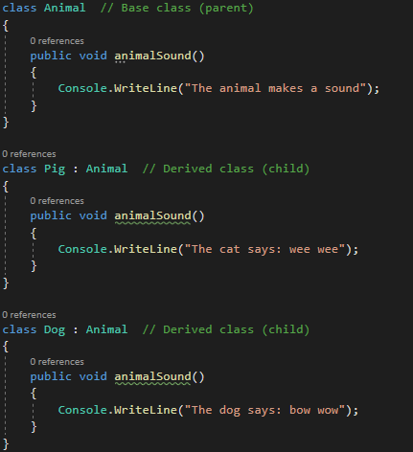
Polymorphism and Overriding Methods
Polymorphism means "many forms", and it occurs when we have many classes that are related to each other by inheritance.
Inheritance lets us inherit fields and methods from another class. Polymorphism uses those methods to perform different tasks.
This allows us to perform a single action in different ways.
For example, think of a base class called Animal that has a method called animalSound(). Derived classes of Animals could be Cats, Dogs, Birds - And they also have their own implementation of an animal sound (the cat meows, dog barks and bird chirps):

Slide 19
THANKS!

